Slide 1

Linked List
Dr. J.Govindarajan
Asst. Prof. (Sr.Gr)
CSE Department

Slide 2
Linked Lists
Types
Singly Linked Lists
Circularly Linked Lists
Double Linked Lists
Properties
Functions
Simple problems

Slide 3
List using Array
0 | 1 | 2 | 3 | 4 | 5
40 | 20 | 30 | 50 | 60 | 10
- index is used to read and write
For example, t = A[3]
A[4] = 25

Slide 4
Linked List
A linked list, in its simplest form, is a collection of nodes that collectively form a linear sequence.
Unlike an array, though, in which the linear order is determined by the array indices, the order in a linked list is determined by a pointer in each object. Linked lists provide a simple, flexible representation for dynamic sets.

Slide 5
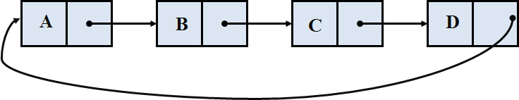
Linked List : Types
Singly Linked Lists
Circularly Linked Lists
Double Linked Lists
A
B
C
D
∅
∅
A
B
C
D
∅

Slide 6
Singly Linked List
A singly linked list is a concrete data structure consisting of a sequence of nodes
Each node stores
Element (reference to the object)
Link (or) reference to the next node
A
B
C
D
∅
next
elem
node

Slide 7
Singly Linked List
A list has been defined to consists of an order set of elements which may vary in number. A simplest way to represent a linear list is to expand each node to contain link to next node. This representation is one-way chain or singly linked list.

Slide 8
Singly Linked List : Example
Players List sorted based on scores
<P1, 10> <P2, 20> <P3,30> <P4,50>
<P1,10>
<P2,20>
<P3,30>
<P4,50>
∅

Slide 9
Sorted Players List (sorted based on scores)
Required Operations:
Print the players with scores in the sorted order
Update the score of an player
Remove the player from the game
Add a player to the game

Slide 10
Sorted Players List
Print the players with scores in the sorted order
<P1,10>
<P2,20>
<P3,30>
<P4,50>
∅

Slide 11
Sorted Players List
Print the players with scores in the sorted order
<P1,10>
<P2,20>
<P3,30>
<P4,50>
∅

Slide 12
Sorted Players List
Print the players with scores in the sorted order
<P1,10>
<P2,20>
<P3,30>
<P4,50>
∅
First node
Last node
Traversing the list from first node to last node

Slide 13
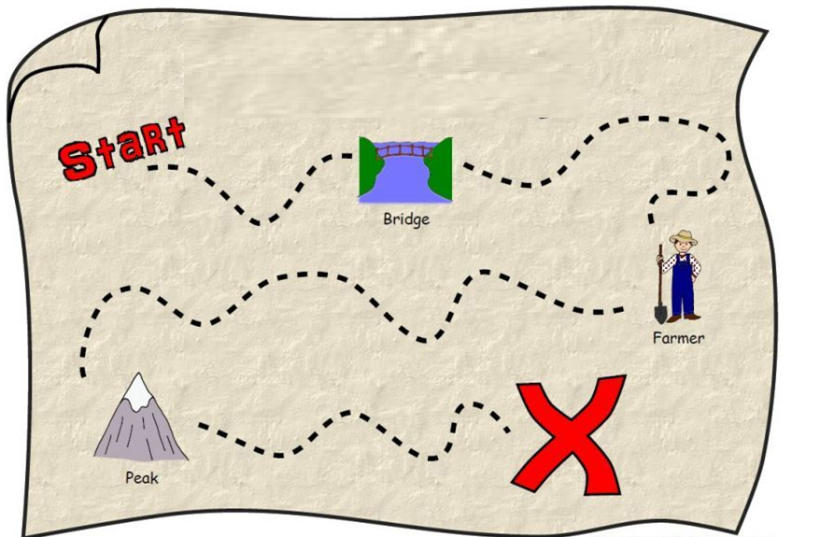
Treasure Hunt

Slide 14
Singly Linked List with head variable

Slide 15
Sorted Players List
Print the players with scores in the sorted order
<P1,10>
<P2,20>
<P3,30>
<P4,50>
∅
First node (or) head
Maintain the reference of first node i.e., head node

Slide 16
Sorted Players List : Traverse and print
Print the players with scores in the sorted order
temp
<P1,10>
<P2,20>
<P3,30>
<P4,50>
∅
First node (or) head
Use one variable for traversing
Initialization : temp = head

Slide 17
Sorted Players List : Traverse and print
Print the player (i.e., first player) name and score
temp
<P1,10>
<P2,20>
<P3,30>
<P4,50>
∅
Output:
P1 10
First node (or) head
Print temp.element.name
Print temp.element.score

Slide 18
Sorted Players List : Traverse and print
Move the temp using next
temp
<P1,10>
<P2,20>
<P3,30>
<P4,50>
∅
Output:
P1 10
First node (or) head
temp=temp.next

Slide 19
Sorted Players List : Traverse and print
Print the player (i.e., second player) name and score
temp
<P1,10>
<P2,20>
<P3,30>
<P4,50>
∅
Output:
P1 10
P2 20
First node (or) head
Print temp.element.name
Print temp.element.score

Slide 20
Sorted Players List : Traverse and print
Move the temp using next
temp
<P1,10>
<P2,20>
<P3,30>
<P4,50>
∅
Last node
Output:
P1 10
P2 20
First node (or) head
temp=temp.next

Slide 21
Sorted Players List : Traverse and print
Print the player (i.e., third player) name and score
temp
<P1,10>
<P2,20>
<P3,30>
<P4,50>
∅
Output:
P1 10
P2 20
P3 30
First node (or) head
Print temp.element.name
Print temp.element.score

Slide 22
Sorted Players List : Traverse and print
Move the temp using next
temp
<P1,10>
<P2,20>
<P3,30>
<P4,50>
∅
Output:
P1 10
P2 20
P3 30
First node (or) head
temp=temp.next

Slide 23
Sorted Players List : Traverse and print
Print the player (i.e., fourth player) name and score
temp
<P1,10>
<P2,20>
<P3,30>
<P4,50>
∅
Output:
P1 10
P2 20
P3 30
P4 50
First node (or) head
Print temp.element.name
Print temp.element.score

Slide 24
Sorted Players List : Traverse and print
Move the temp using next
temp
<P1,10>
<P2,20>
<P3,30>
<P4,50>
∅
Output:
P1 10
P2 20
P3 30
P4 50
First node (or) head
temp = temp.next

Slide 25
Sorted Players List : Traverse and print
Now the temp is pointing to NULL. That means, end of the list is reached.
temp
<P1,10>
<P2,20>
<P3,30>
<P4,50>
∅
Output:
P1 10
P2 20
P3 30
P4 50
First node (or) head

Slide 26
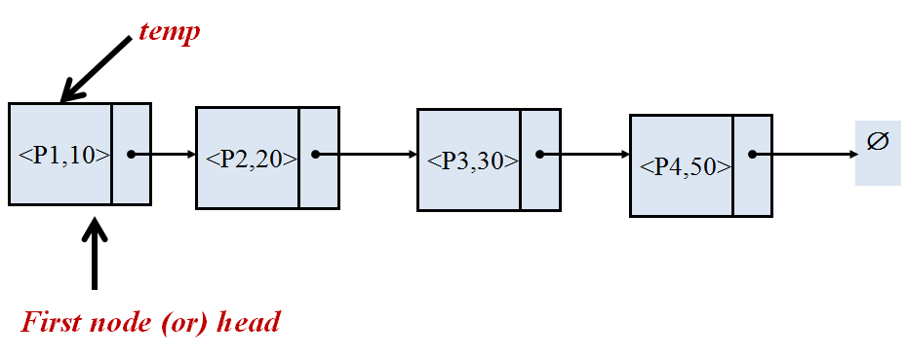
Traversing and Printing the elements in Linked List
temp = head
while (temp is not NULL) do
print temp.element.name
print temp.element.score
temp = temp.next

Slide 27
Sorted Players List : Update
Update the score of a player. For example, new score of the player 3 (p3) is 40
<P1,10>
<P2,20>
<P3,30>
<P4,50>
∅
First node (or) head
Traverse from head till P3 and update the score

Slide 28
Sorted Players List : Traverse and Update a node
Start the traversal from head
temp
<P1,10>
<P2,20>
<P3,30>
<P4,50>
∅
First node (or) head
Use one variable for traversing
Initialization : temp = head

Slide 29
Sorted Players List : Traverse and Update a node
The element of current “temp” is not P3 hence move to next node
temp
<P1,10>
<P2,20>
<P3,30>
<P4,50>
∅
First node (or) head
“temp.element.name==P3” is false
temp = temp.next

Slide 30
Sorted Players List : Traverse and Update a node
The element of current “temp” is not P3 hence move to next node
temp
<P1,10>
<P2,20>
<P3,30>
<P4,50>
∅
First node (or) head
“temp.element.name==P3” is false
temp = temp.next

Slide 31
Sorted Players List : Traverse and Update a node
The element of current “temp” is P3 hence update
temp
<P1,10>
<P2,20>
<P3,30>
<P4,50>
∅
First node (or) head
“temp.element.name==P3” is true
temp.element.score = 40

Slide 32
Sorted Players List : Traverse and Update a node
The list after the update
temp
<P1,10>
<P2,20>
<P3,40>
<P4,50>
∅
First node (or) head

Slide 33
Traverse and update a node of the Linked List
temp = head
while ( temp is not NULL ) do
if (temp.element.name==P3) then
temp.element.score = newscore
else
temp = temp.next

Slide 34
Sorted Players List : Remove an node
Remove a player from the list. For example, remove the player 3 (p3)
<P1,10>
<P2,20>
<P3,30>
<P4,50>
∅
First node (or) head
Traverse from head till P2 and update the next node

Slide 35


Sorted Players List : Remove an node
Remove a player from the list. For example, remove the player 3 (p3)
temp
<P1,10>
<P2,20>
<P3,30>
<P4,50>
∅
First node (or) head
Traverse from head till P2 and update the next node

Slide 36

Sorted Players List : Remove an node
Remove a player from the list. For example, remove the player 3 (p3)
temp
removenode
<P1,10>
<P2,20>
<P3,30>
<P4,50>
∅
First node (or) head
removenode= temp.next

Slide 37
Sorted Players List : Remove an node
Remove a player from the list. For example, remove the player 3 (p3)
temp
removenode
<P1,10>
<P2,20>
<P3,30>
<P4,50>
∅
First node (or) head
temp.next = removenode.next

Slide 38
Sorted Players List : Remove an node
Remove a player from the list. For example, remove the player 3 (p3)
temp
removenode
<P1,10>
<P2,20>
<P3,30>
<P4,50>
∅
First node (or) head
removenode.next = NULL

Slide 39
Sorted Players List : Remove an node
Remove a player from the list. For example, remove the player 3 (p3)
temp
removenode
<P1,10>
<P2,20>
<P4,50>
∅
First node (or) head
delete removenode

Slide 40
Traverse and Remove a node of the Linked List - remove(pname)
temp = head
while ( temp is not NULL ) do
if (temp.next.element== pname) then
removenode = temp.next
else
temp = temp.next
if (temp is not NULL) then
temp.next = removenode.next
removenode.next=NULL
delete removenode

Slide 41
Sorted Players List : Add an node
Add a player to the list. For example, add a player 5 (p5) with the score 35
<P1,10>
<P2,20>
<P3,30>
<P4,50>
∅
First node (or) head
Traverse from head till P3 and insert the next node with <P5,35> between P3 and P4

Slide 42
Sorted Players List : Add an node
Add a player to the list. For example, add a player 5 (p5) with the score 35
temp
<P1,10>
<P2,20>
<P3,30>
<P4,50>
∅
<P5,35>
First node (or) head
Traverse from head till P3 and insert the next node with <P5,35> between P3 and P4

Slide 43
Sorted Players List : Add an node
Add a player to the list. For example, add a player 5 (p5) with the score 35
temp
<P1,10>
<P2,20>
<P3,30>
<P4,50>
∅
<P5,35>
newnode
First node (or) head
newnode = createnode(player,score)

Slide 44
Sorted Players List : Add an node
Add a player to the list. For example, add a player 5 (p5) with the score 35
temp
<P1,10>
<P2,20>
<P3,30>
<P4,50>
∅
<P5,35>
newnode
First node (or) head
newnode.next = temp.next

Slide 45
Sorted Players List : Add an node
Add a player to the list. For example, add a player 5 (p5) with the score 35 after P3
temp
<P1,10>
<P2,20>
<P3,30>
<P4,50>
∅
<P5,35>
newnode
First node (or) head
temp.next = newnode

Slide 46
Traverse and add a node to Linked List – Add(pname,score)
temp = head
while ( temp is not NULL ) do
if (temp.element.score<score &&
score<temp.next.element.score) then
break #break the while loop
else
temp = temp.next
if (temp is not NULL) then
newnode=Node(element)
newnode.next=temp.next
temp.next = newnode

Slide 47
Time Complexity : Linked List with only Head Pointer
Print the elements of linked list
Update the score of an player in the linked list
Remove the player from the linked list
Add a player to the linked list
O(n)
O(n) in worst case
O(1) in best case

Slide 48
Singly Linked List with head and last variables

Slide 49
Singly Linked List with head and last variables
<P1,10>
<P2,20>
<P3,30>
<P4,50>
∅
head
tail

Slide 50
Singly Linked List with head and tail : Functions
addFirst(e) : Adds a new element to the front of the list
addLast(e) : Adds a new element to the end of the list
removeFirst(): Removes and returns the first element of the list
size() : returns the number of elements in the list
first() : returns the first element in the list
last() : returns the last element in the list.

Slide 51
Initialization()
head = NULL
tail = NULL
size = 0

Slide 52
addFirst(e)
<P1,10>
<P2,20>
<P3,30>
<P4,50>
∅
Algorithm addFirst(e):
newnode = Node(e)
newnode.next = head
head = newnode
If tail == NULL then
tail = head
size = size+1
head
tail
<P1,10>
<P2,20>
<P3,30>
<P4,50>
∅
O(1)
newnode
tail
<P5,5>
head

Slide 53
addLast(e)
Algorithm addLast(e):
newnode = Node(e)
newnode.next = NULL
tail.next = newnode
tail = newnode
If head == NULL then
head = tail
size = size+1
<P1,10>
<P2,20>
<P3,30>
<P4,50>
∅
head
tail
<P1,10>
<P2,20>
<P3,30>
<P4,50>
O(1)
head
<P5,60>
tail
∅

Slide 54
removeFirst()
<P1,10>
<P2,20>
<P3,30>
<P4,50>
∅
Algorithm removeFirst():
If head == NULL then
return # list is empty
else
head = head.next
If tail == NULL then
tail = head
size = size-1
head
tail
<P2,20>
<P3,30>
<P4,50>
∅
O(1)
head
tail

Slide 55
size() , first(), last()
Algorithm size()
return size
Algorithm first()
if head==NULL
return NULL
else
return head.element
Algorithm last()
if last==NULL
return NULL
else
return last.element
O(1)

Slide 56
Problems
Write an algorithm to remove the last node from the singly linked list with only head pointer. Also specify the time complexity.
Write an algorithm to remove the lastnode from the singly linked list with head and tail pointers. Also specify the time complexity.

Slide 57
Problems
Consider the following singly link list. Write an algorithm to find out the players with maximum and minimum scores. Also, specify the time complexity.
<P1,60>
<P2,40>
<P3,10>
<P4,50>
∅
head
tail

Slide 58
Text Book Reference
Refer Goodrich MT, Tamassia R, Goldwasser MH. Data structures and algorithms in Python. John Wiley & Sons Ltd; 2013”

Slide 59
Other References
Goodrich MT, Tamassia R, Data structures and algorithms in Java. Fifth edition, John Wiley & Sons; 2010.
Tremblay JP, Sorenson PG. An introduction to data structures with applications. Second Edition, McGraw-Hill; 2002.
Shaffer CA. Data Structures and Algorithm Analysis. Third Edition, Dover Publications; 2012.

Slide 60
Online Meet
Online meet is on scheduled on 6th April 2020 from 6 to 7 PM to discuss and clarify the doubts.
The room id and password for online meet using yoteachapp.com will be shared.
Quiz and Assignment
Online Quiz is on scheduled on 7th April 2020 from 6 to 6.30 PM.
In addition Assignment will be opened on 7th April 2020.

